Slide 1
Plastic Bag & Styrofoam Bans, Other Strategies
July 30, 2011
Gretchen Brewer
Earth Circle

Slide 2
CA Supreme Court Decision
Manhattan Beach vs. Save the Plastic Bag Coalition
Court found unanimously that:
  Small govt need not do EIR
  Negative declaration sufficient to meet CEQA
Yet to see how this will play out with larger jurisdictions

Slide 3
Bag Ban Cascade
On strength of Manhattan Beach decision, two latest bans in US:
  Bellingham, WA
  Portland, OR
Many other pending bans rolling forward in CA and elsewhere

Slide 4
Quick Count of Single-Use
Bag Bans/Fees Adopted
Global total: 134
US
  CA 23
  23 other states 30
Other Countries: 81
  Including Bangladesh, Ireland, Israel, Italy, Japan, Mumbai, Mozambique, New Zealand, Taiwan, Turkey, United Kingdom
  - Portia Sinnott, NCRA News

Slide 5
Styro Bans Then and Now
Plethora of bans in 1980’s
  Berkeley, CA and Suffolk County, NY among the first
  Ultimately forced McDonald’s & others to drop styrofoam clamshells
  Sparked innovation of alternative carry-out containers (pulped paper, etc)
BUT industry outlasted/reversed many measures over time

Slide 6
Difference Now
Social media allows massive organizing & groundswell engagement everywhere
Blessed Unrest:
  Many players & approaches
  Broad coalitions
  Steady pressure
Surprises, e.g., 4th grade class successfully petitioned San Diego Unified School District for study of alternatives to styro lunch trays & possible ban

Slide 7
A Few Key Groups
Clean Seas Coalition – the lead coalition in California – over 30 environmental groups
  http://www.cleanseascoalition.org
  Formed by Lt. Governor John Garamendi to realize Ocean Protection Council’s pollution reduction recommendations.
Plastic Pollution Coalition
  http://plasticpollutioncoalition.org/
  Campaigns against disposable plastics and for the “4 Rs” of sustainable living: Refuse, Reduce, Reuse, Recycle

Slide 8
Heal The Bay
  http://www.healthebay.org/
Surfrider – Rise Above Plastics campaign
  http://www.riseaboveplastics.blogspot.com/
Save our Shores
  http://www.saveourshores.org/
Green Sangha – Inspiring Awakened Action
  http://www.greensangha.org/plastics-campaign/
Chico Bags – map of plastic bag bans
  http://www.chicobags.com

Slide 9
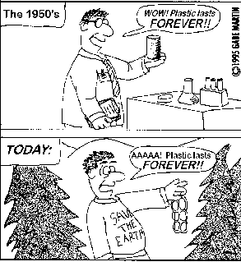

Slide 10
To Deal with Plastics
Bans & other campaigns raise awareness and can prompt real changes
Yet much more needs to be done to stem the flow of plastics to the oceans & counter the many other negative impacts of throw-away plastics

Slide 11
A Few More Strategies
Maximize plastics recovery in US
  Fewer exports mean less plastics falling off of container ships
Rebuild our plastics recycling infrastructure
  Many plants installed in 90’s now closed
Utilize proven, high-end plastics recycling technologies

Slide 12
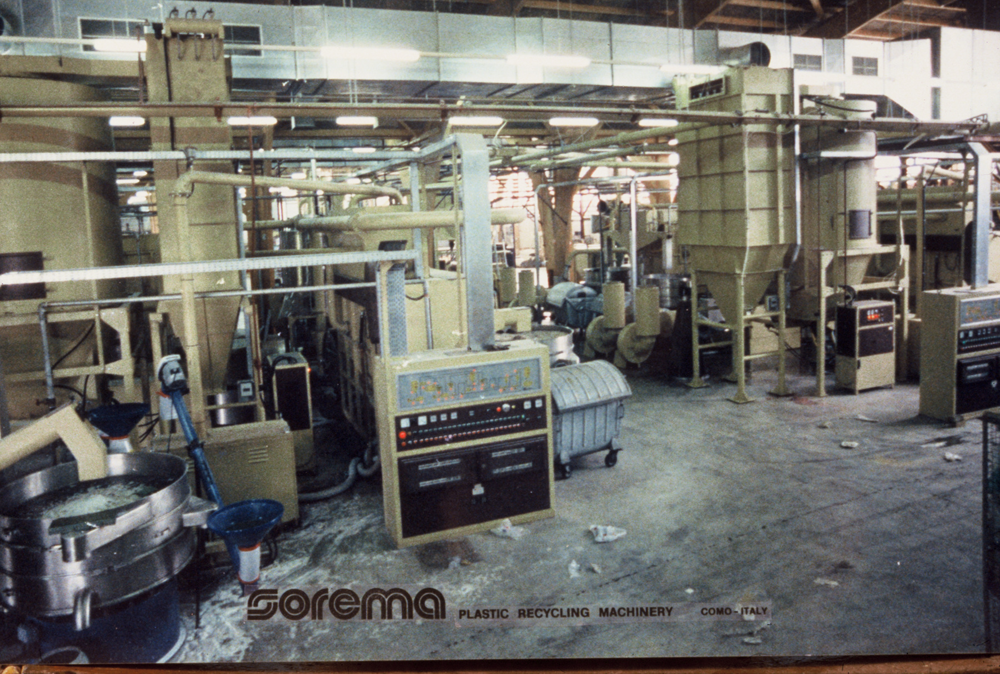
State-of-art plastics recycling plant: many proven systems for film, bottles, or rigid

Slide 13
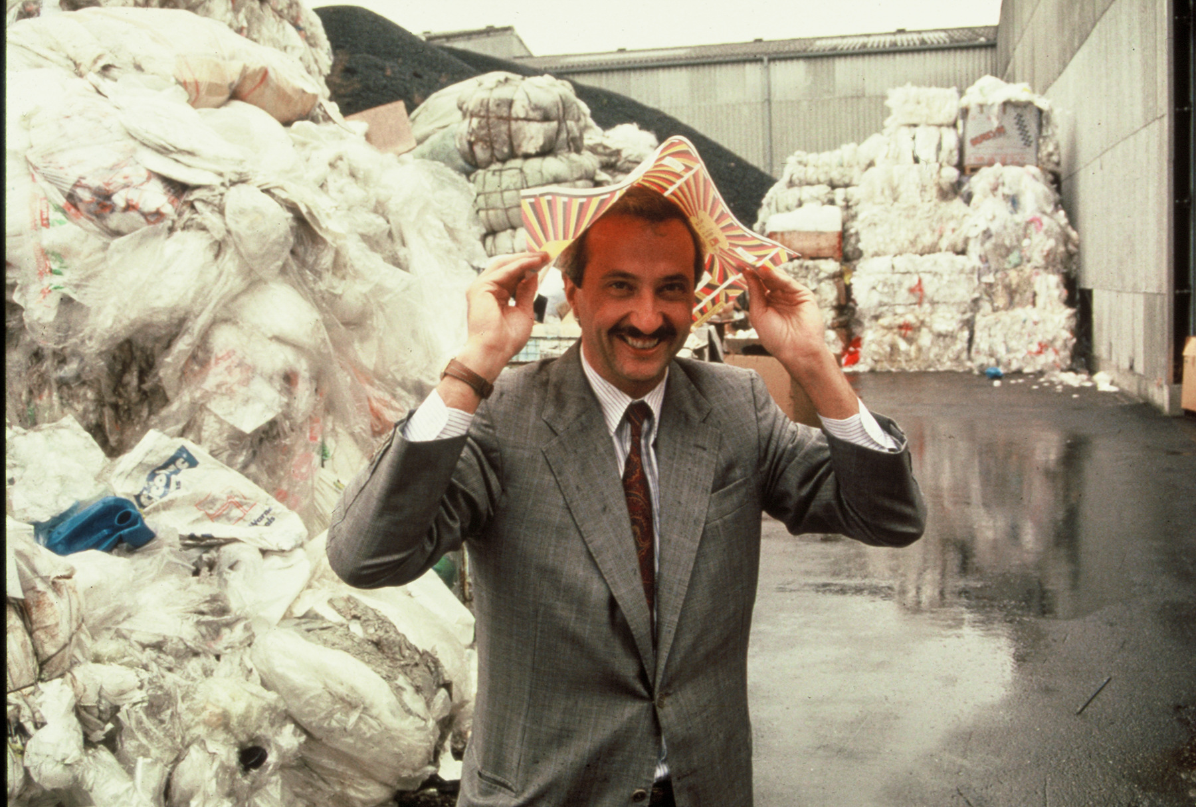
Sorema inventor (Italy) started in 70’s with most difficult material - dirty agricultural film

Slide 14
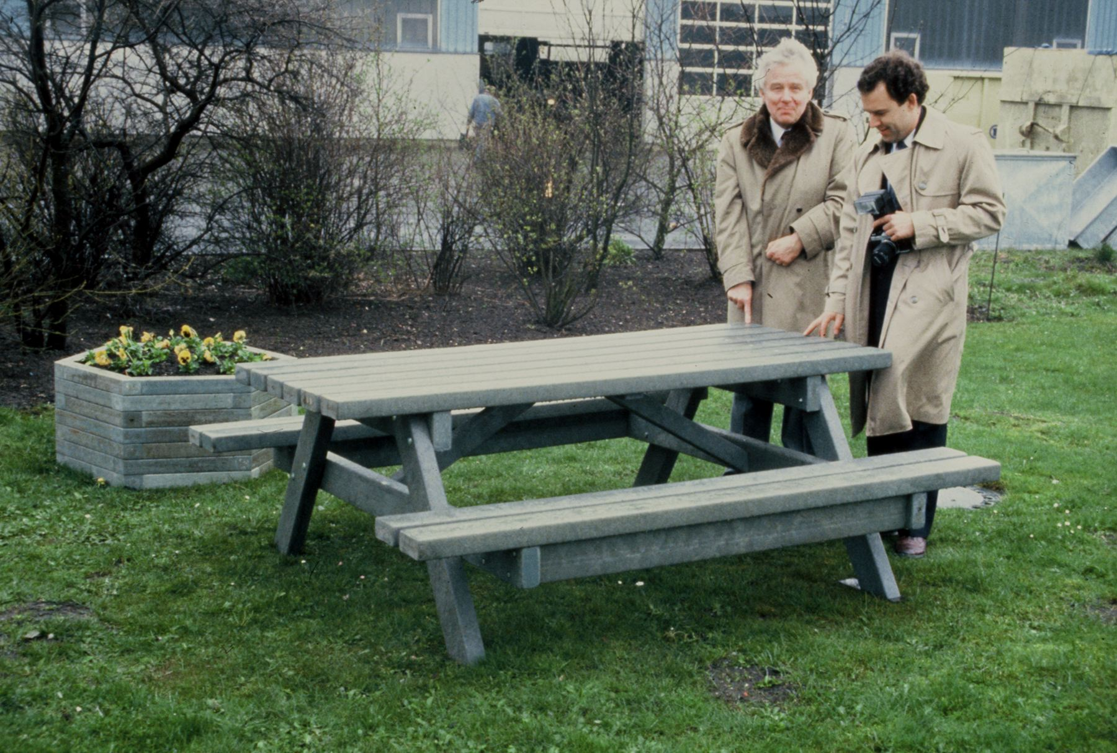
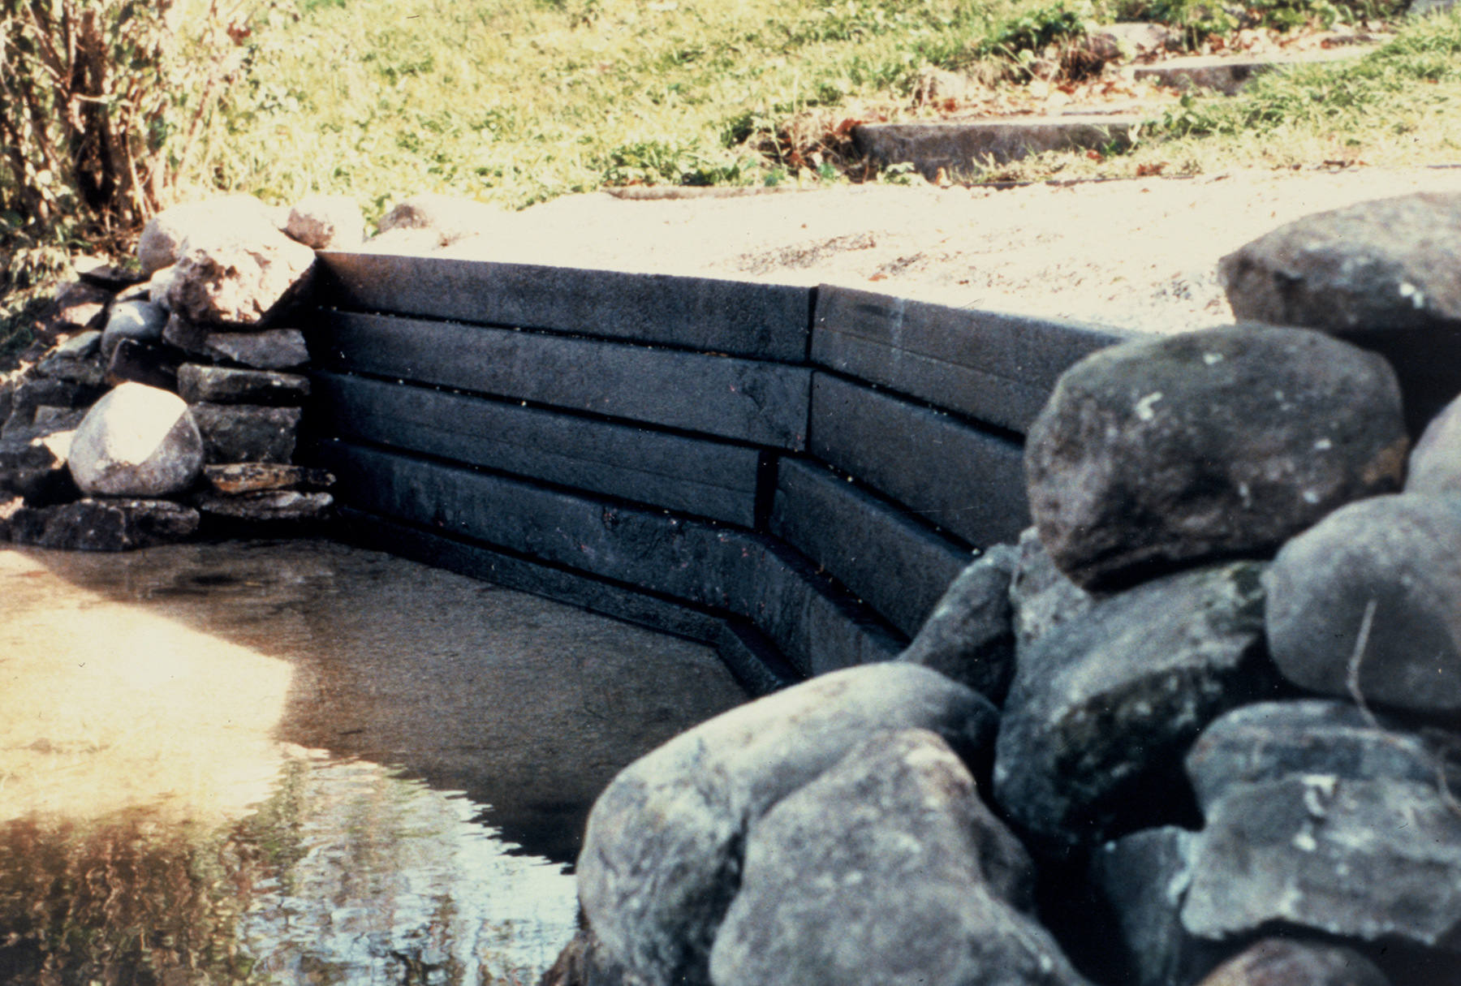
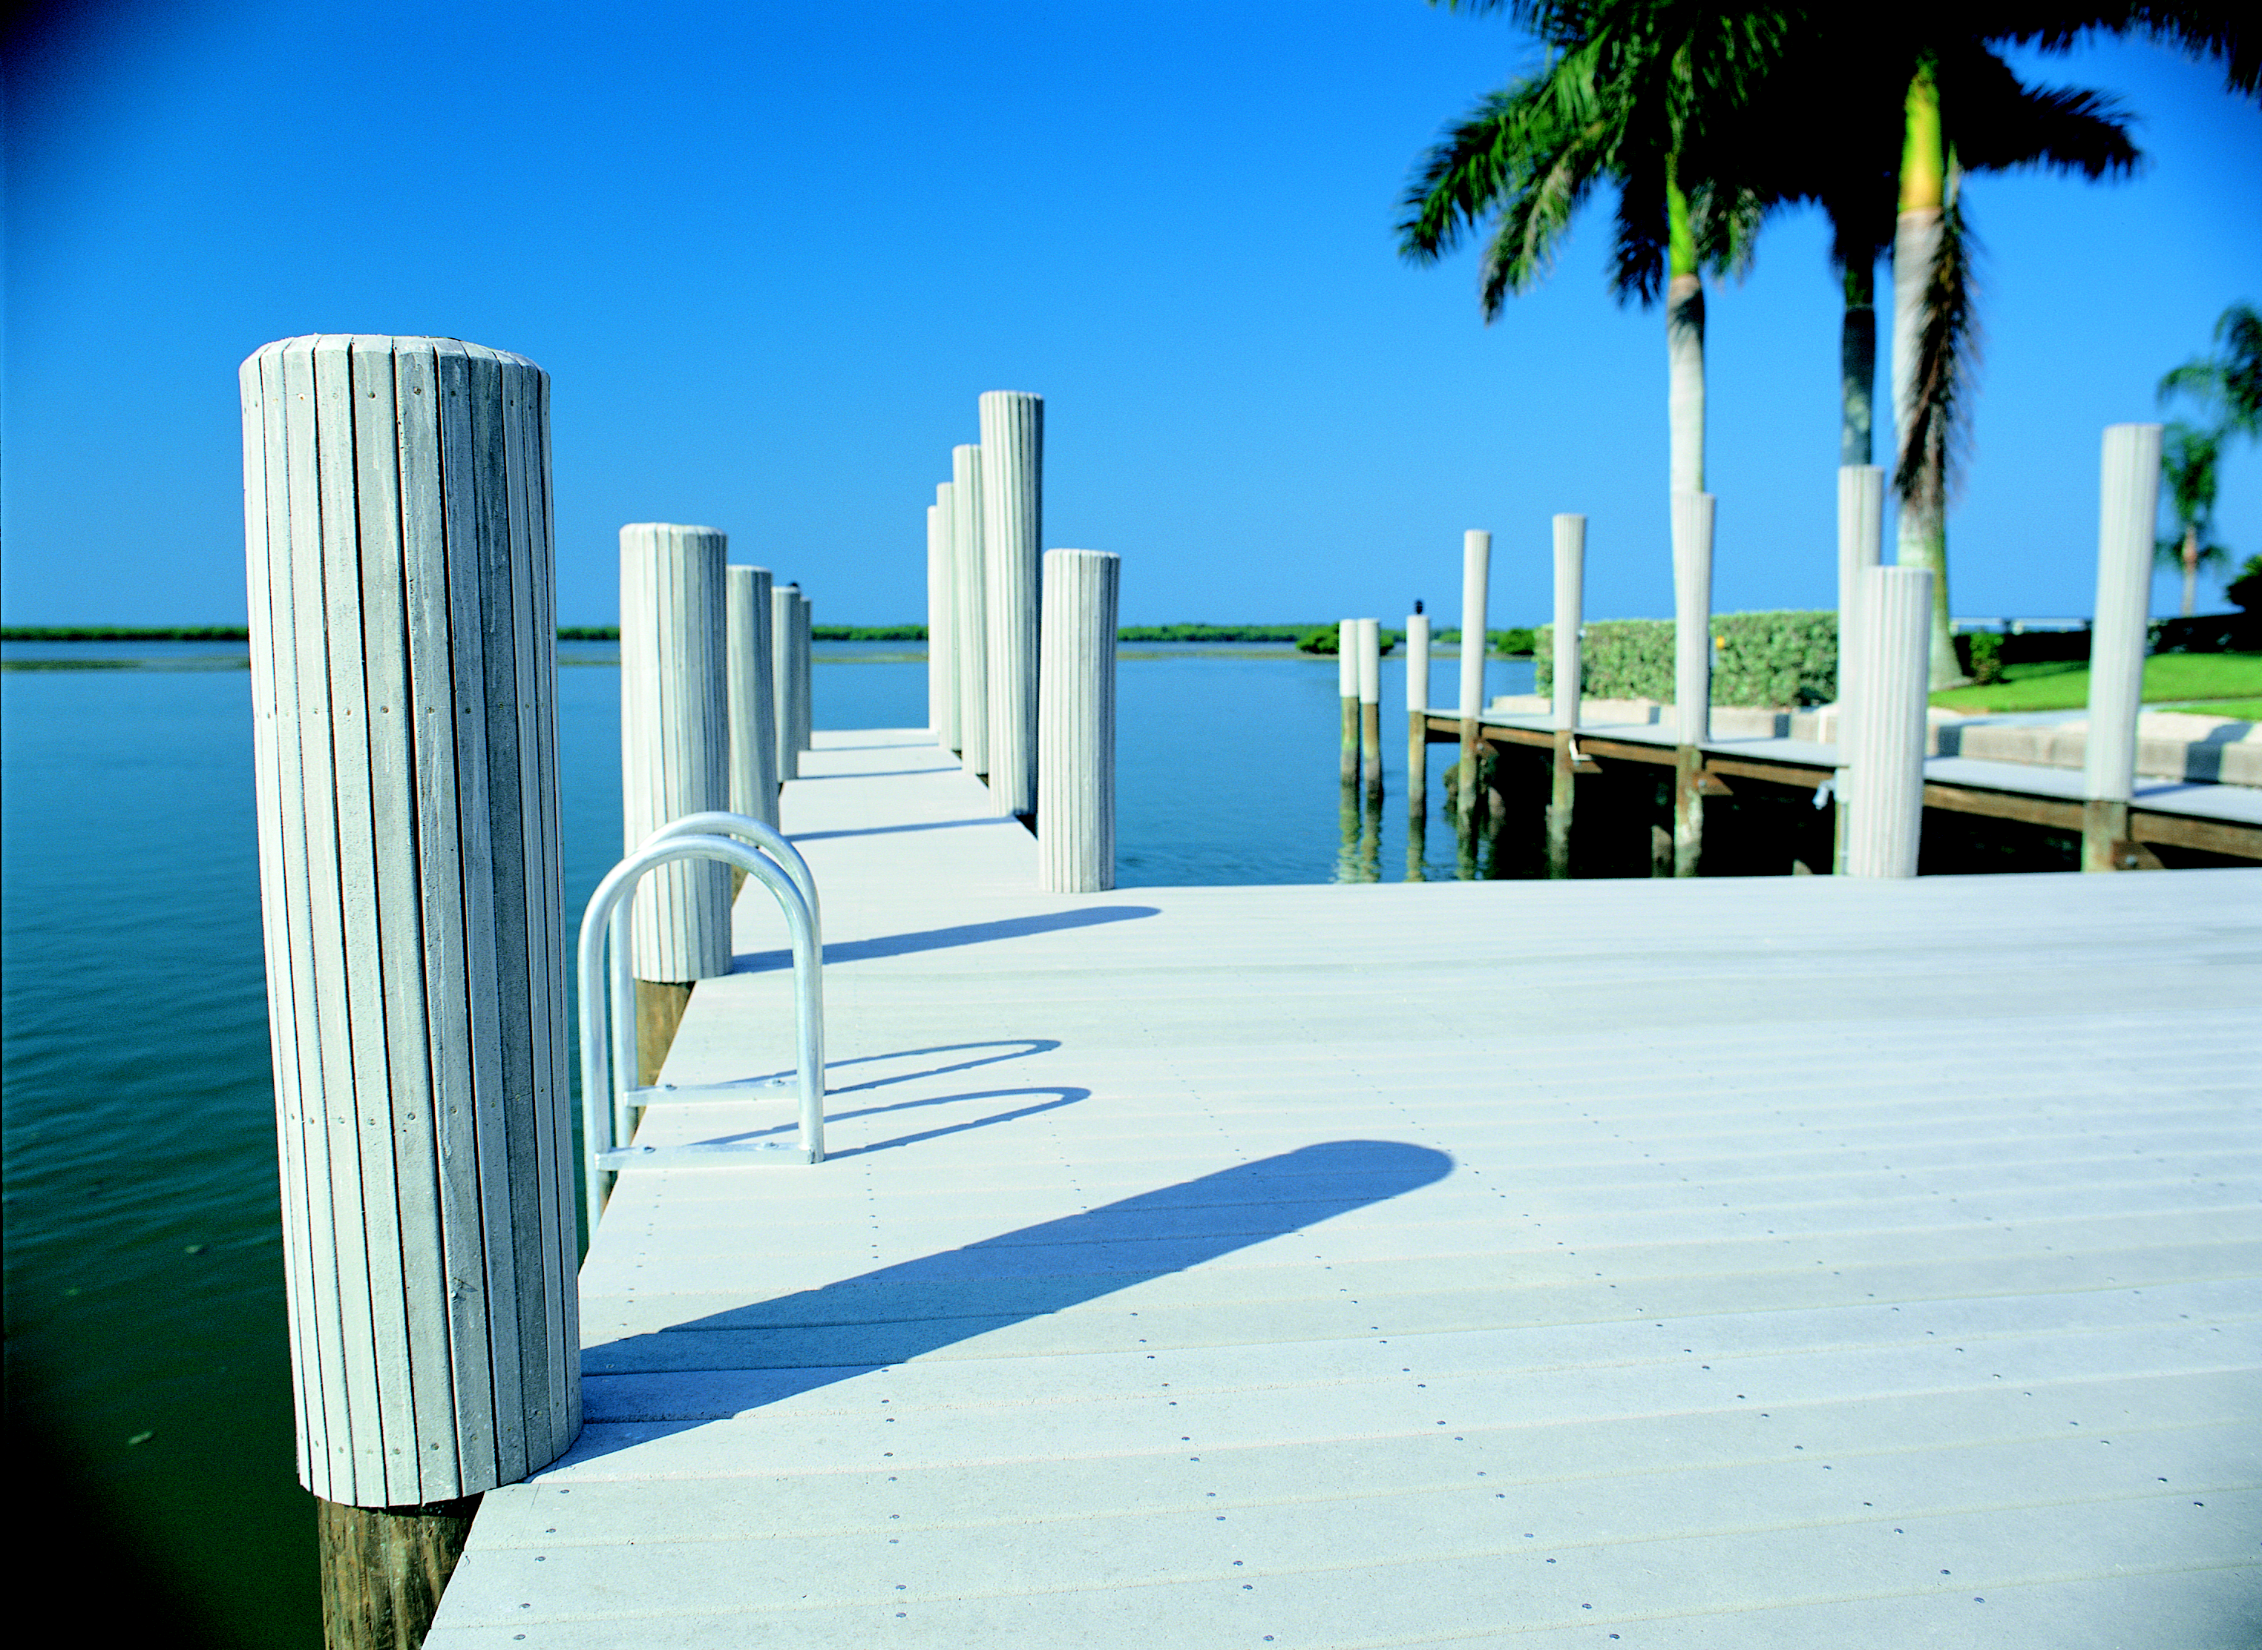
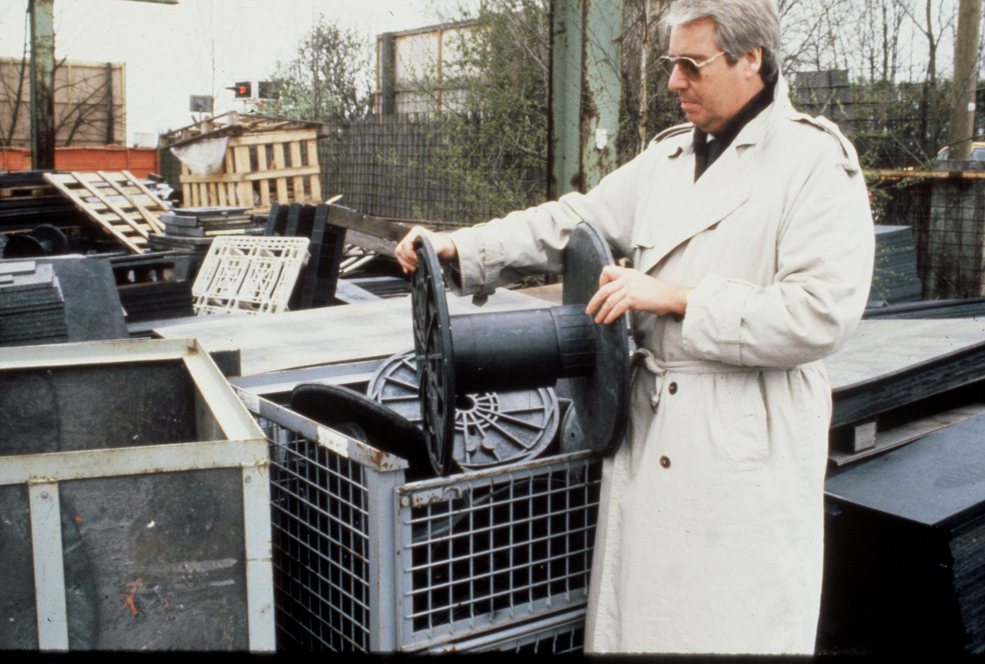
Mixed plastic systems produce rugged, products impervious to rot, bugs, chemicals, graffiti, elements
Notes:
Clockwise from upper left: JET mixed plastic picnic table, Iowa Plastics mixed plastic landscape timber, Recycloplast cable reel, Trex decking lumber on marina (technically, Trex products are NOT made of mixed plastics; rather 50% PE film & 50% hardwood sawdust)

Slide 15
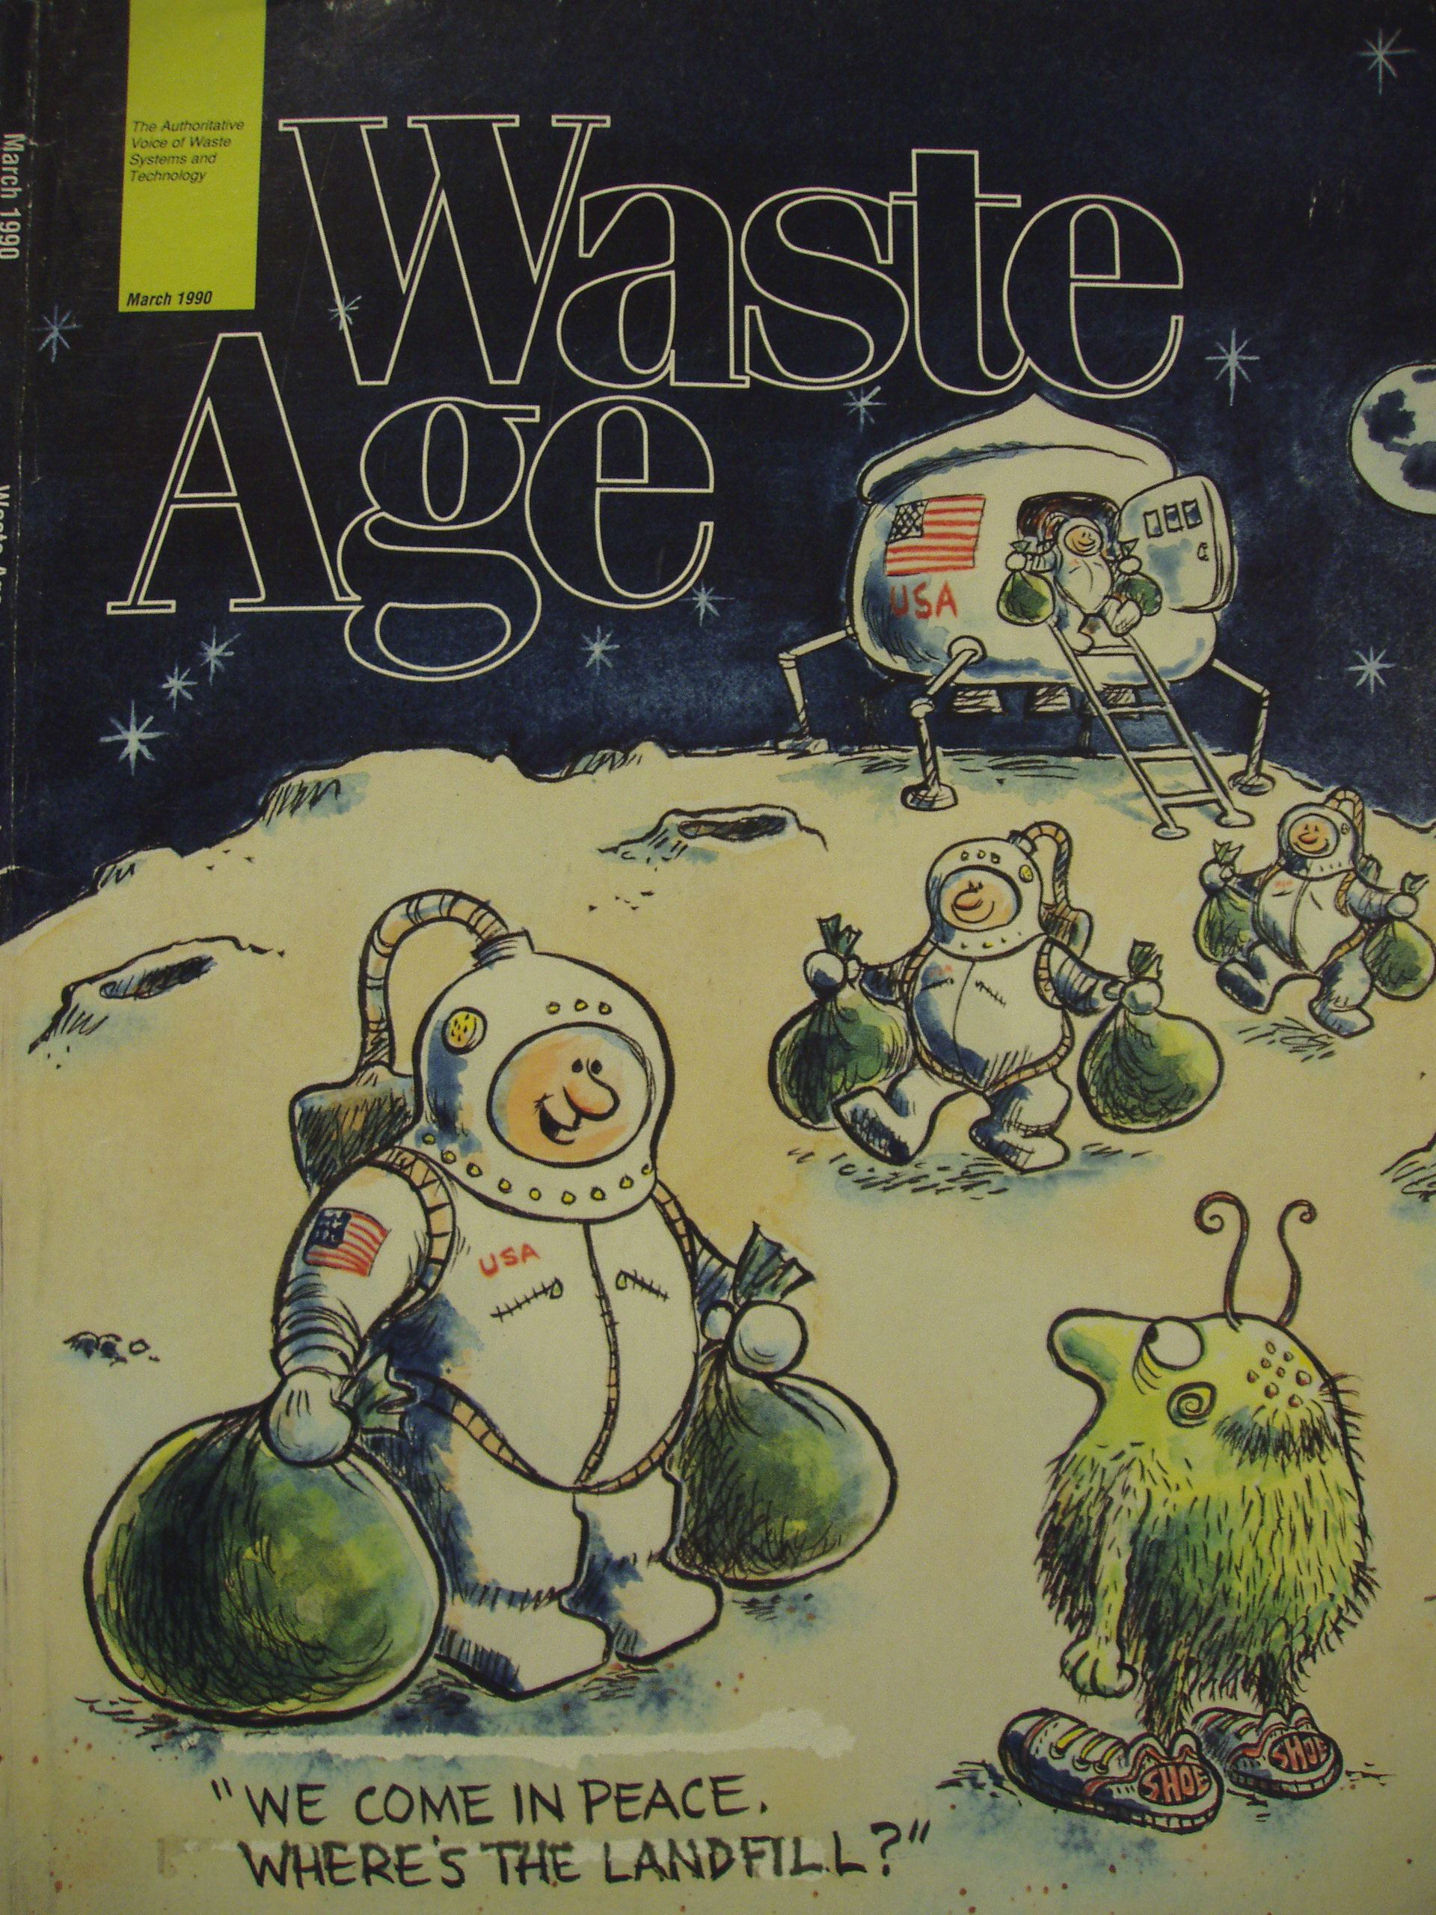
We don’t have another planet

Slide 16
But we do have huge opportunities
To educate
To innovate
To foster holistic approaches
To invent new green industries and professions for a rapidly changing world
To engage a new generation of Zero Wasters in a bright future!

Slide 17
“We humans created these problems, and I believe we humans have the capability to solve them.”
- Tom Padia, StopWaste.org

