Slide 1
Producer Responsibility:
It’s Catching On & Changing
Product Design

Slide 2

“We should recycle, but it is not the first thing
we should do, it is the last. Redesign first,
then reduce, reuse and finally recycle, if there
is no other alternative.”
Bill McDonough, Co-author of Cradle to Cradle
Credit: Bev Thorpe, Clean Production Action

Slide 3
Products and Packaging Matter

Slide 4
David Stitzhal’s “Things to Keep in Mind”
More and more products are being addressed by product stewardship policies.
Product stewardship embraces a wide range of tools and mechanisms.
Europe, Asia and Canada are rapidly developing product stewardship policies that address life‐cycle impacts.
Product policies are in a time of growth and transition --most policies are less than twenty years old.
Be careful about unintended effects and net negative impacts.
One size won’t fit all to drive future green design.
Don’t reject a tool because it doesn’t solve all problems.

Slide 5
2011 Green Brands Survey Shows Wide International Support
“Companies must take back products, such as electronics, at the end of their useful life”
79 points #1
66 points
68 points
76 points #1
76 points #2
62 points
68 points #2
56 points

Slide 6
Broad Bi-Partisan Support in Texas
The vast majority of the Tea Party TX Housemembers vote for TV Takeback

Slide 7

Unlikely Support Can Be Found
Gov. Rick Perry (TX)
Former Gov. Mike Huckabee (AR)
Former Gov. Mark Sanford (SC)
Former Gov. Jon Huntsman (UT)
Texas Conservative Caucus
Consumer Electronics Association

Slide 8
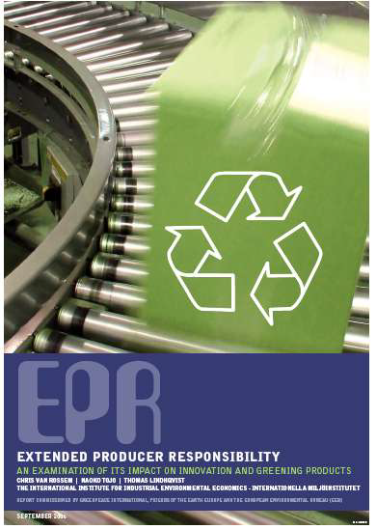
Producer TakeBack Laws Affecting Design of Vehicles and Electronic & Electrical Equipment
“Accelerated actions occurred after the emergence of the EPR legislation in Japan, in contrast to voluntary design guidelines on end-of-life management.
The contrast between the design guidelines and EPR legislation also demonstrates the role of take-back requirements in effectively linking downstream and upstream.”
Naoko Tojo, author of “Extended Producer Responsibility as a Driver for Design Change - Utopia or Reality?”

Slide 9
Key Factor
“The more control the manufacturers have over the downstream infrastructure, the more likely it is that measures belonging to the higher ladder of resource efficiency will be taken.”
- Naoko Tojo

Slide 10
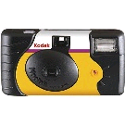
Case in Point:
The number of Kodak one-time-use cameras recycled is now approaching 1 billion.
The portion of Kodak’s manufacturing volume originating from recycled cameras is close to 90%.

Slide 11

What the company says:
“Dell designs its products with a cradle to cradle approach… We are constantly innovating to make it easier for your product to be upgraded, recycled or refurbished when it no longer serves your needs. ”
“Our designers work with recyclers at the beginning of a product’s life to make sure the end of its life isn’t wasteful.”

Slide 12
Examples of Dell Design Changes
Modularity — The majority of components are easily removable, with standardized parts. This makes it easier to reuse or recycle them.
Easy disassembly — reduced the number of screws in products, and the ones that remain are easier to access and more consistent in type. All parts are easily separable with commonly found tools.
Minimal glues and adhesives — replaced with snap fits & other more methods that don’t hamper recycling
Restrictions on paints and coatings — use integral finishes instead of exterior coatings, which can interfere with the recycling process or degrade certain plastics during processing. If paint is the only option, use paint that is compatible with recycling.

Slide 13

Panasonic built the Matsushita Eco Technology Center (METEC) in western Japan and reports:
“METEC is providing feedback to product designers. Developing products that will be easier to dismantle and sort when they are recycled is an important way that Matsushita can help build a recycling society.”
Credit: Lynne Pledger “Extended Producer Responsibility and Product Design”

Slide 14
More Japanese companies tout design for recycling efforts
Sharp and Mitsubishi launched the Kansai Recycle Systems facility in Osaka to recycle household appliances. From a corporate report:
“Kansai…holds recycling design seminars aimed at providing product design engineers with feedback from the recycling plant on how to design easy‐to‐recycle products.”
Sony recycles its televisions at 15 recycling plants across Japan. Sony is the principal shareholder in one of the plants: Green Cycle Corp. According to their corporate report:
“Feedback from such research helps television designers and engineers create new products that are easier to recycle.”
Credit: Lynne Pledger “Extended Producer Responsibility and Product Design”

Slide 15
Examples of Design Changes by Japanese Electronics Makers
NEC, Hitachi, Fujitsu, Matsushita and Sony replaced plastic housings with magnesium alloy for TV cabinets and personal computers, owing to the low plastic recycling results.
Sony Ericsson eliminated the use of beryllium, anticipating future recycling advantages.
Sony recycles waste material from plastic optical film for use in the BRAVIA LCD TVs
Credit: Lynne Pledger “Extended Producer Responsibility and Product Design”

Slide 16
Packaging Changes in Germany
Reduce Waste
Toothpaste tubes are found on store shelves with no cardboard packaging.
Tubes have been designed with broad flat caps so they can be displayed standing on end.
Brands are displayed in large open boxes with a dozen or more tubes per box.
Credit: Lynne Pledger “Extended Producer Responsibility and Product Design”

Slide 17
More Resources on EPR & Product Design
Product Policy Institute under EPR Issues
www.productpolicy.org
International Institute for Industrial Environmental Economics at Lund University
www.iiiee.lu.se/
Clean Production Action
www.cleanproduction.org

Slide 18
Thanks for your attention!
Robin Schneider
Robin@TexasEnvironment.org
(512) 326-5655
Texas Campaign for the Environment Fund
and
Central Texas Zero Waste Alliance
“We’ll stop at nothing”

